Slide 1
Understanding Co-Parenting
with a Hexaflex Lens
Jenna Macri, Jenn Daks, & Ron Rogge
University of Rochester

Slide 2
PAIR
P
ROMOTING
A
WARENESS
R
ELATIONSHIPS
I
MPROVING
Self-guided
Completed in the home
Watch movie
30-45 min guided discussion
rel dynamics on screen
similar/different?
➔ promotes acceptance / awareness / compassion

Slide 3
PAIR
Cuts divorce rate
(Rogge et al., 2013)
Promotes:
➔ communication
➔ awareness
Boosts relationship quality
(Rogge et al., 2016)
Enjoyable and fun
➔ Diffusion
➔ self-as-context
Notes:
Promotes attentive awareness
→ awareness
- own behavior
- rel dynamics

Slide 4
PAIR
Cuts divorce rate
(Rogge et al., 2013)
Promotes:
➔ communication
➔ awareness
Boosts relationship quality
(Rogge et al., 2016)
Enjoyable and fun
➔ Diffusion
➔ self-as-context
Notes:
Promotes attentive awareness
→ awareness
- own behavior
- rel dynamics

Slide 5
REFLECT
R
EFLECTING TO
E
NRICH
L
IFE AND
F
AMILY
E
NHANCE
C
O-PARENTING
T
EAMWORK
Same structure as PAIR
Self-guided
Watch movie
30-45min guided discussion
parenting on screen?
similar/different?
➔ promotes acceptance / awareness / compassion
Notes:
Same structure as PAIR
Movies focus on parental portrayals
Discussions focus on: parent cooperation, conflict, triangulation

Slide 6
Goals
RCT on REFLECT
Waitlist vs. REFLECT
Co-parent dyads of toddlers
Online
Parenting
Co-parenting
Contextual Behavioral Science Lens
Psychological flexibility
Mechanisms of change?
Notes:
Coparent dyads of 2-3 year old children
Online with phone screening
Waitlist vs. REFLECT
Parenting gains (e.g. warmth, affection, reasoning)
Co-parenting gains (e.g. cooperation & support)
Improvements in parenting communication (greater frequency and depth of coparenting discussions; reduced avoidance), quality of coparenting (greater coparenting cooperation and support; reduced parental conflict and disagreement), and use of effective parenting styles (greater parental warmth, affection, reasoning, & democratic inclusion; reduced parental laxness, verbal hostility, over-reactivity, and corporal punishment).
Coparental Cooperation
Experiential Avoidance
Parenting Communication
Inductive Reasoning with Children

Slide 7
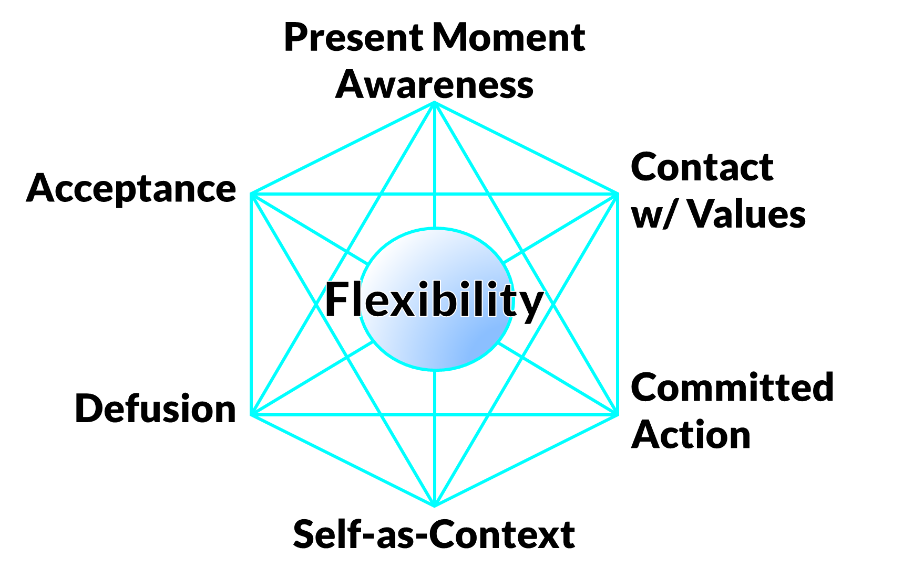
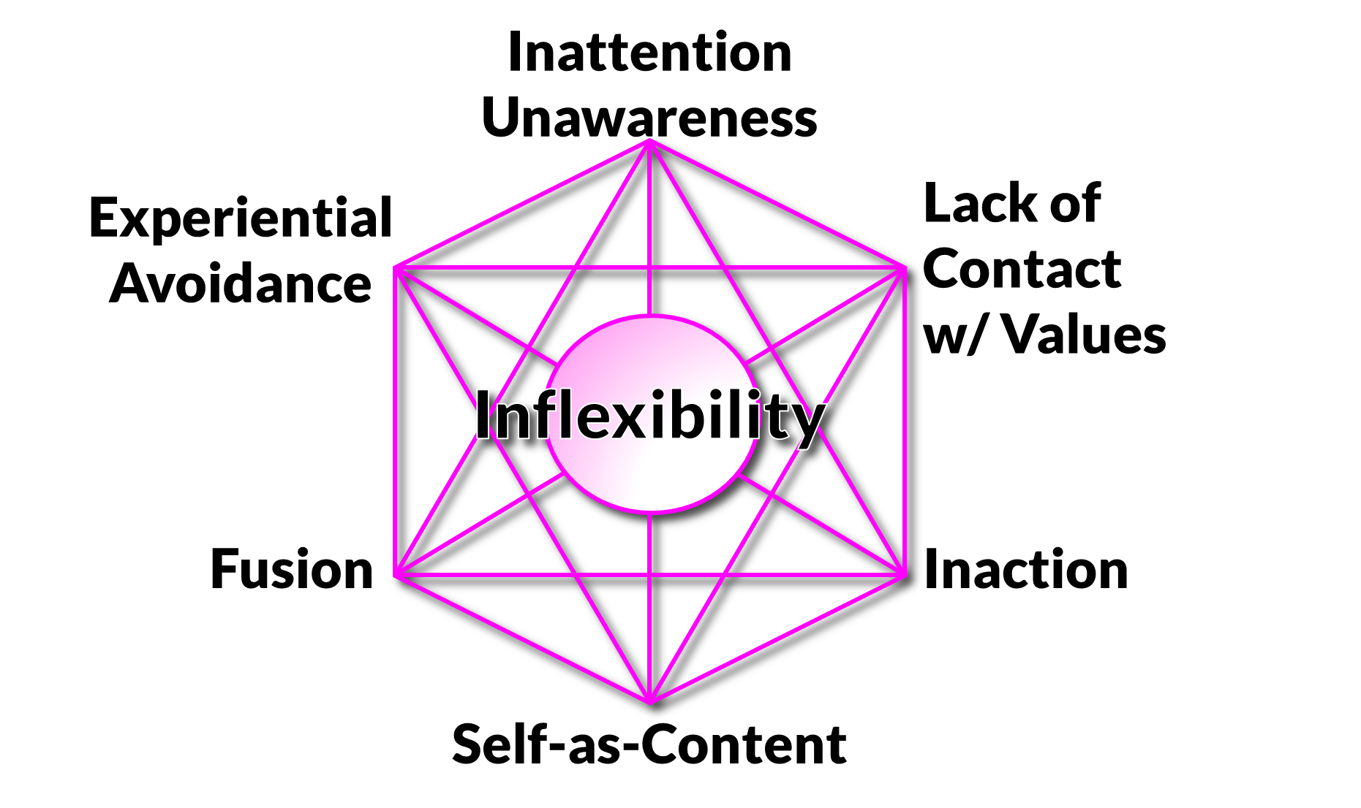
Psychological flexibility
MPFI

Slide 8
Method: Participants
Recruited
Parenting groups
ResearchMatch
➔ 63 families
126 coparents
Parent M_{age} = 33yrs
83% White
95% married
63% used childcare
Children M_{age} = 2.8yo
35% male
Notes:
describe online study, recruitment, REFLECT vs Waitlist, one month follow-up

Slide 9
Method: Procedure
Weekly movie discussions
Baseline survey
Random Assignment
1 month follow up
Wait list control
Notes:
describe online study, recruitment, REFLECT vs Waitlist, one month follow-up
Procedure
Mothers & Fathers completed 30min baseline survey
Randomly assigned to REFLECT or Waitlist
Matched on initial co-parenting
Emailed links to movies & discussion questions weekly
83% (52 families) provided 1 month follow-up data

Slide 10
Mediation model
Δ FLEX / INFLEX
Path B
Path A
REFLECT
Δ Parenting outcomes
Path C

Slide 11
Results
Δ FLEX / INFLEX
REFLECT
Path C
Δ Parenting outcomes
ANCOVA
REFLECT vs. Waitlist
Differences @ 1mo
Controllling for baseline
REFLECT
➔ Lower Coparent Conflict
REFLECT
➔ Improved dynamics
Communication
Support
Cooperation (Mothers)
Responsiveness
Bond with partner
Inductive reasoning (Fathers)
Bond with child (Mothers)

Slide 12
Results
Δ FLEX / INFLEX
Path A
REFLECT
Δ Parenting outcomes
FATHERS
MARGINAL INCREASES IN SELF-AS-CONTEXT FROM REFLECT
HELPED TO MAINTAIN A BROADER PERSPECTIVE DURING PARENING
MOTHERS
MARGINAL DROPS IN EXPERIENTIAL AVOIDANCE FROM REFLECT
HELPED TO ENGAGE EVEN DIFFICULT PARENTING EXPERIENCES

Slide 13
Results
Δ FLEX / INFLEX
Path B
REFLECT
Δ Parenting outcomes
CORRELATED CHANGE ACROSS ONE MONTH
CHANGE IN FLEX ➔ CHANGE IN PARENTING
DROPS IN EXPERIENTIAL AVOIDANCE
not significant
INCREASES IN SELF AS CONTEXT
SUPPORT
COMMUNICATION
RESPONSIVENESS
INDUCTIVE REASONING
BOND WITH COPARENT
BOND WITH CHILD

Slide 14
Mediation model
Δ FLEX / INFLEX
Path B
Path A
REFLECT
Δ Parenting outcomes
Path C

Slide 15
LIMITATIONS
Online study
Higher SES
Entirely self-report
Brief intervention
Brief follow-up
Notes:
make an offline version
seek greater diversity
collect coparental behavioral data
extend both

Slide 16
THANK YOU!!!
Notes:
My mentor, Dr. Ronald Rogge

